Slide 1

TRA THANH SECONDARY SCHOOL
Welcome to our English class
VÕ THỊ CHÂU PHƯỢNG

Slide 2
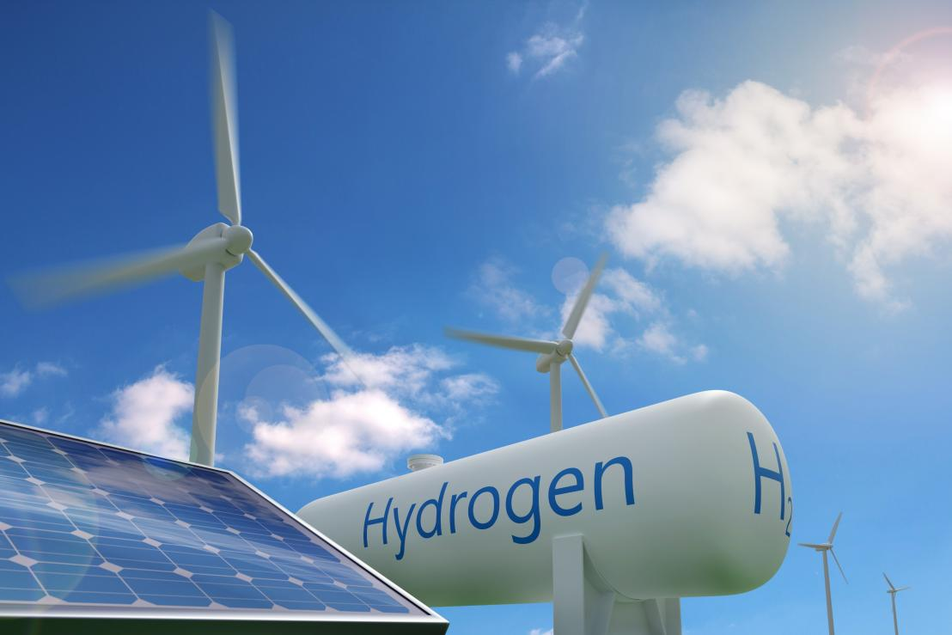
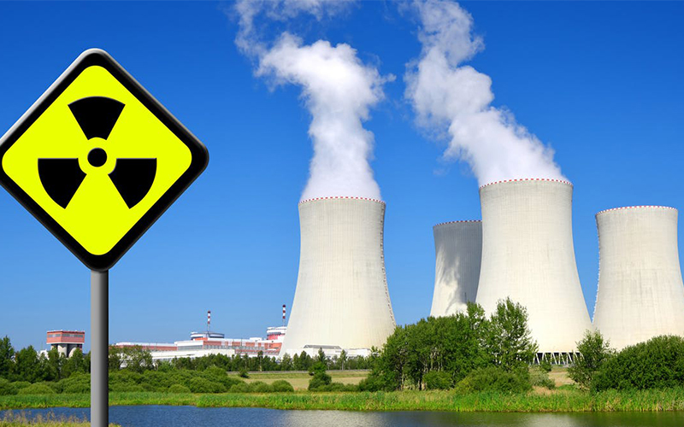
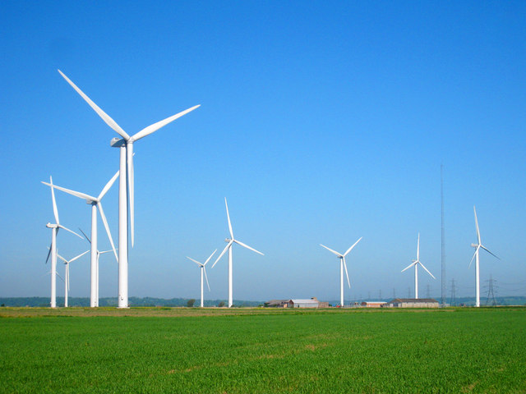
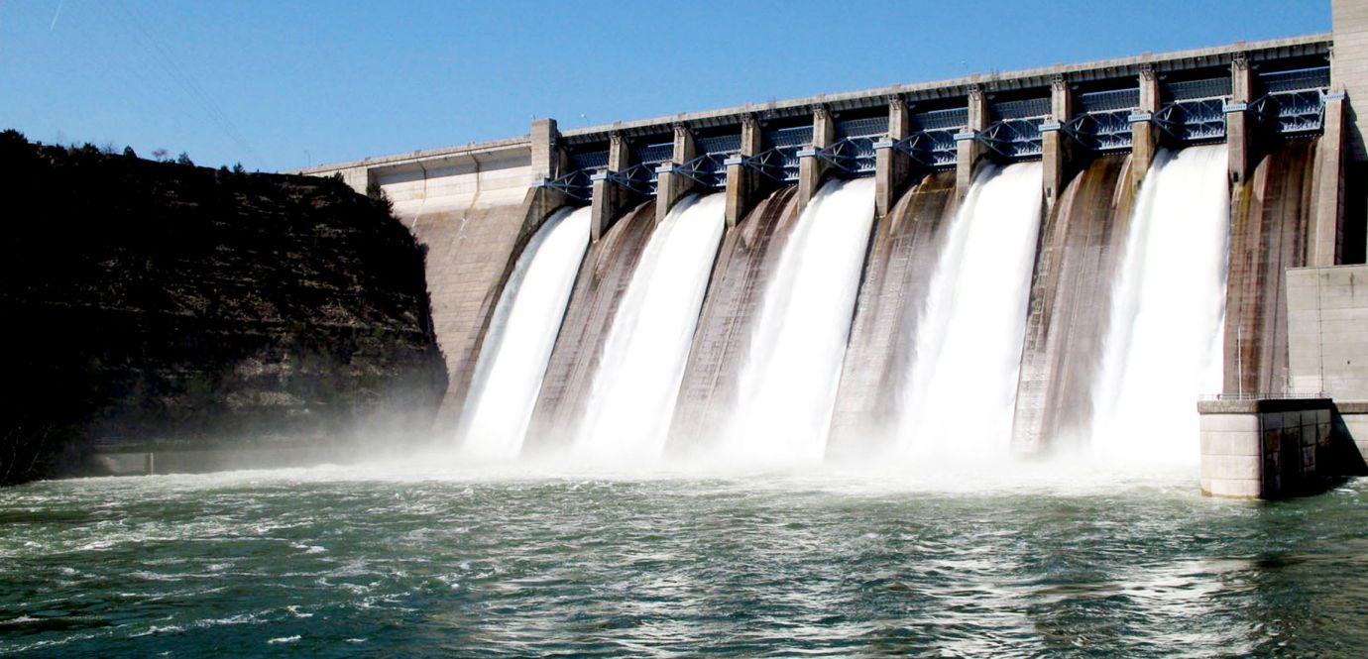
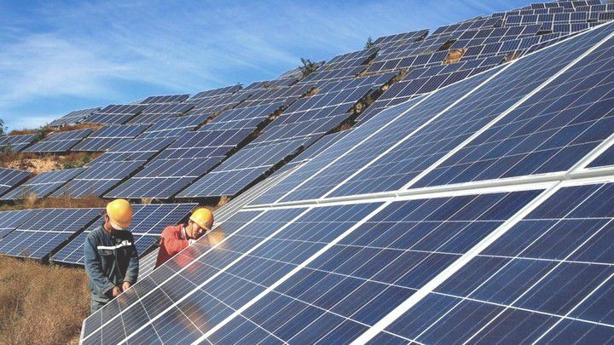
Match the names of the energy souces to the pictures
Solar energy
Solar energy
Nuclear energy
Nuclear energy
Wind energy
Wind energy
Hydro energy
Water energy
Hydro energy
Water energy
Energy sources
a
b
c
d
e

Slide 3
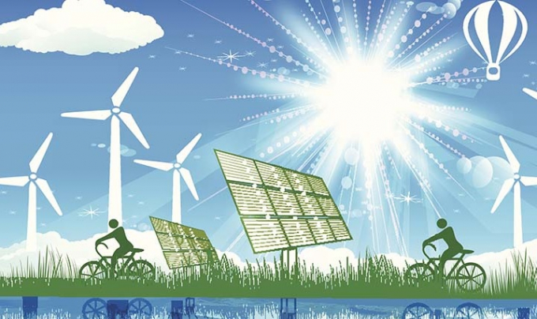
UNIT 10: ENERGY SOURCES
Period 80: Getting started

Slide 4
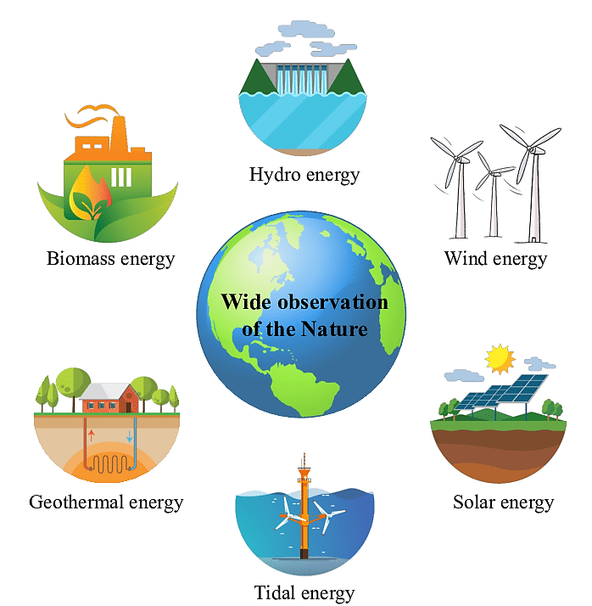
* Vocabulary
- energy source (n):
Nguồn năng lượng

Slide 5

* Vocabulary
- coal (n):
Than đá

Slide 6
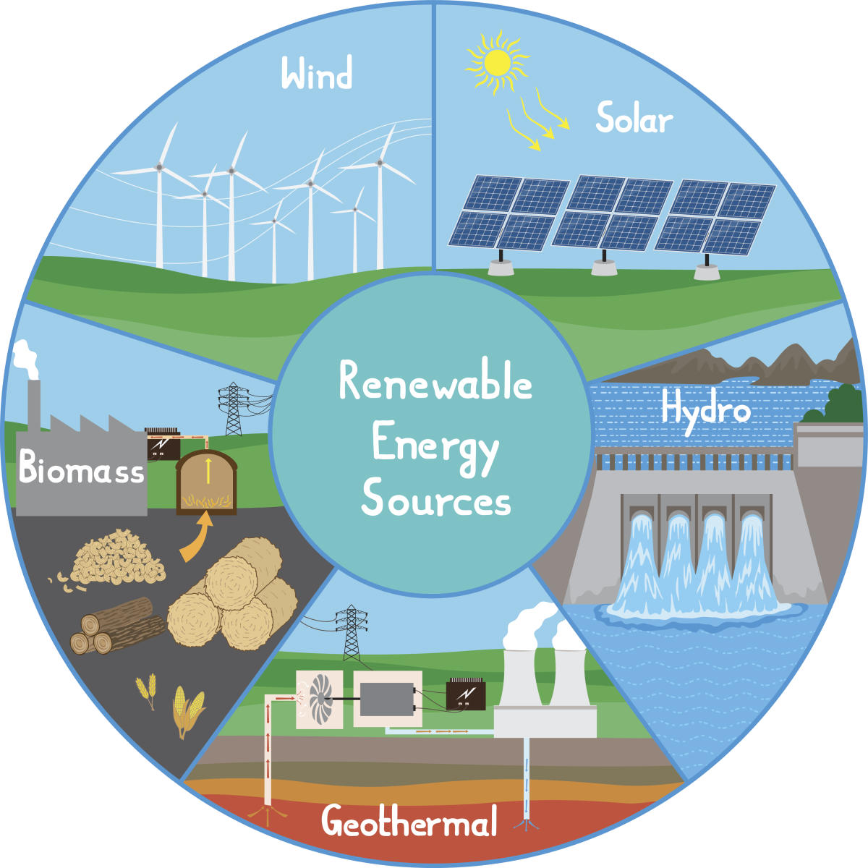
* Vocabulary
- renewable (a):
có thể tái tạo được

Slide 7
* Vocabulary
- replace (v):
thay thế
To put something or someone in the place of something or someone

Slide 8
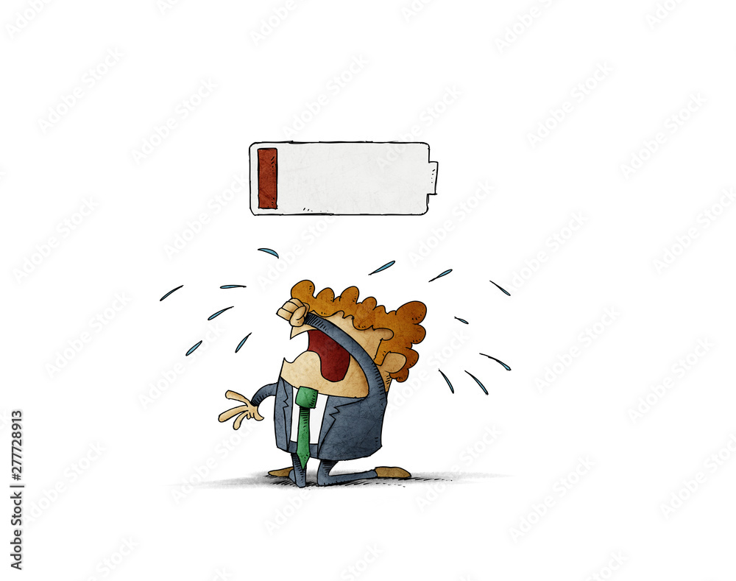
* Vocabulary
- run out of (phr v):
cạn kiệt

Slide 9
* Vocabulary
New words | Pronunciation | Meaning
energy source (n) | /ˈenədʒi sɔːs/ | nguồn năng lượng
coal (n) | /kəʊl/ | than đá
renewable (adj) | /rɪˈnjuːəbl/ | có thể tái tạo được
run out of (phr v) | /rʌn aʊt ɒv/ | cạn kiệt
replace (v) | /rɪˈpleɪs/ | Thay thế

Slide 10

Checking vocabulary
c
Matching
energy source (n)
cạn kiệt
coal (n)
có thể tái tạo được
renewable (adj)
thay thế
replace (v)
nguồn năng lượng
run out of (ph.v)
than đá

Slide 11

1
1. Who are they in the conversation?
They are Lan and Mr. Tan.
2. What are Lan and Mr. Tan (her father) talking about?

Slide 12

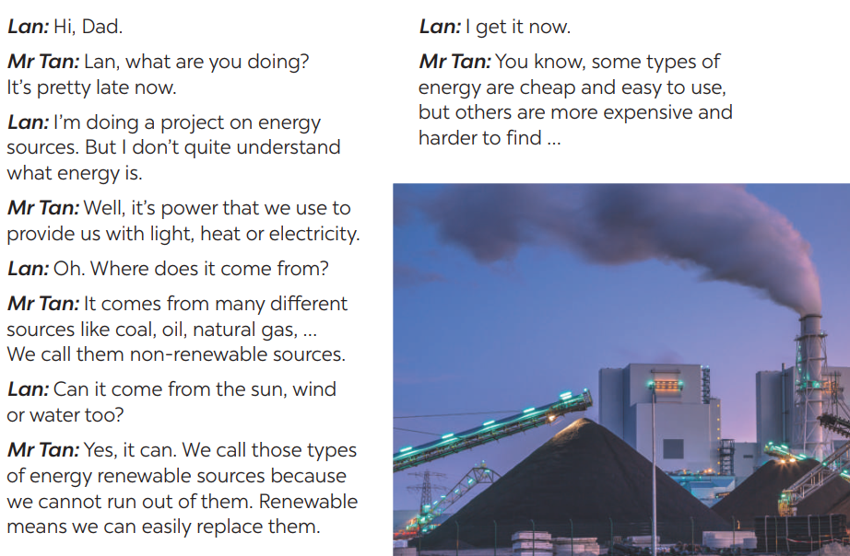
1
Listen and read

Slide 13

2. What are Lan and her father talking about?
=> Energy sources

Slide 14
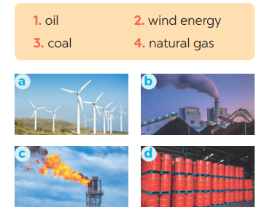
4. Match the words/ phrases in the box with the correct pictures.
3. Read the conversation again and answer the questions.
1. What is Lan doing?
2. What does energy mean?
3. Where does energy come from?
4. What are renewable sources?

Slide 15
LUCKY NUMBERS
LUCKY NUMBERS
LUCKY NUMBERS
LUCKY NUMBERS
1
2
3
4
5
6
7
8
9
10
A
14
A
A
2
4
4
6
8
10
12
B
14
B
B
2
4
6
8
10
12

Slide 16
10
9
8
7
6
5
4
3
2
1
0
1. What is Lan doing?
⬧
She is doing a project on energy sources.

Slide 17
10
9
8
7
6
5
4
3
2
1
0
2. What does energy mean?
⬧
It’s power that we use to provide us with light,
heat or electricity..

Slide 18
10
9
8
7
6
5
4
3
2
1
0
3. Where does energy come from?
⬧
It comes from many different sources like coal,
oil, natural gas, … and renewable sources

Slide 19
10
9
8
7
6
5
4
3
2
1
0
4. What are renewable sources?
⬧
Renewable sources are those we can easily
replace them such as: water, sun,…

Slide 20
10
9
8
7
6
5
4
3
2
1
0
5. What is this?
⬧
It is the wind energy.

Slide 21
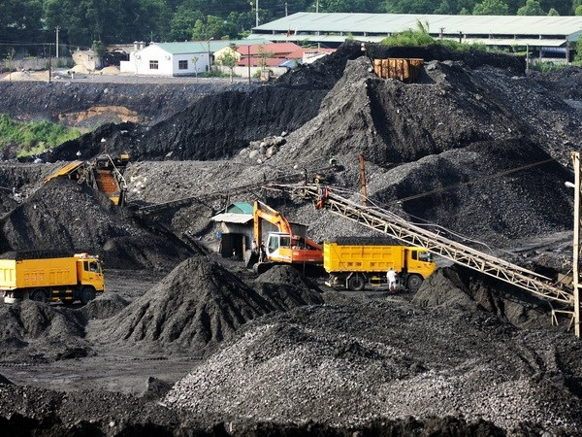
10
9
8
7
6
5
4
3
2
1
0
6. What is this?
⬧
It is coal.

Slide 22
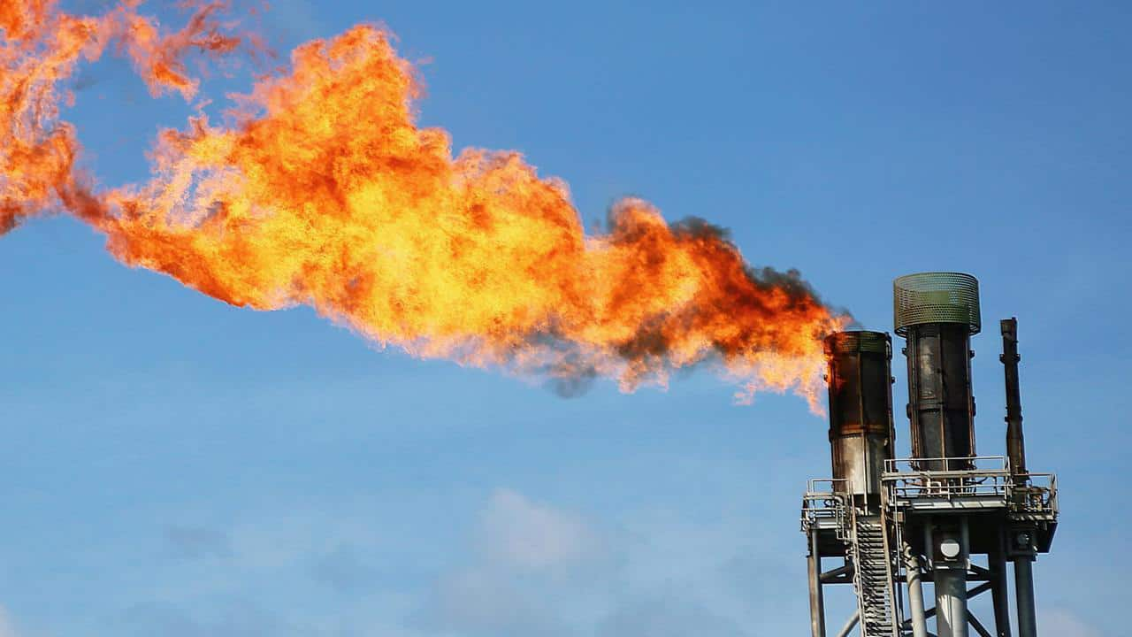
10
9
8
7
6
5
4
3
2
1
0
7. What is this?
⬧
It is natural gas.

Slide 23
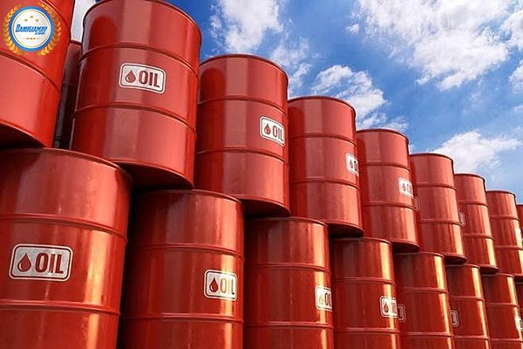
10
9
8
7
6
5
4
3
2
1
0
8. What is this?
⬧
It is oil.

Slide 24



Slide 25

5
Complete each of the sentences with the correct word from the conversation
1. Energy is ___________that we use to provide us with light, heat or electricity.
2. When energy comes from the__________, wind and water, we call it renewable energy.
3. When energy comes from wind, we call it __________energy.
4. We cannot _________ out of renewable energy.
5. Some types of energy are _________and easy to use.

Slide 26
5
Complete each of the sentences with the correct word from the conversation
power
1. Energy is ___________that we use to provide us with light, heat or electricity.

Slide 27
5
Complete each of the sentences with the correct word from the conversation
sun
2. When energy comes from the__________, wind and water, we call it renewable energy.

Slide 28
5
Complete each of the sentences with the correct word from the conversation
wind
3. When energy comes from wind, we call it ________energy.

Slide 29
5
Complete each of the sentences with the correct word from the conversation
4. We cannot ________ out of renewable energy.
run

Slide 30
5
Complete each of the sentences with the correct word from the conversation
cheap
5. Some types of energy are _________and easy to use.

Slide 31
5
Complete each of the sentences with the correct word from the conversation
1. Energy is power that we use to provide us with light, heat or electricity.
2. When energy comes from the sun, wind and water, we call it renewable energy.
3. When energy comes from wind, we call it wind energy.
4. We cannot run out of renewable energy.
5. Some types of energy are cheap and easy to use.

Slide 32
Discussion:
Renewable sources:
Non-renewable sources:
Sun
Sun
Sun
Petroleum
Wind
Natural gas
Water
Oil
Tides
Coal
Fuels
Hydro
Biomass
Nuclear
Geothermal

Slide 33
* CONSOLIDATION
ENERGY SOURCES
TYPES OF ENERGY
SOURCES OF ENERGY
Topic of the unit
Vocabulary

Slide 34


- Do the exercises again.
- Learn by heart the new words.
- Prepare the next lesson: A closer look 1.

Slide 35

Thanks for your attendance!
Goodbye. See you again

